Slide 1
A forthcoming decoder-only foundation model for time-series forecasting and further research
p3n & tonic takeover 🤗huggingface #readinggroup
learn all about synthetic time-series data
what we liked , what we want to do next
🚀

Slide 2
Timeseries Forecasting :
What is it actually?
Do you have any examples ?
What is it used for ?

Slide 3
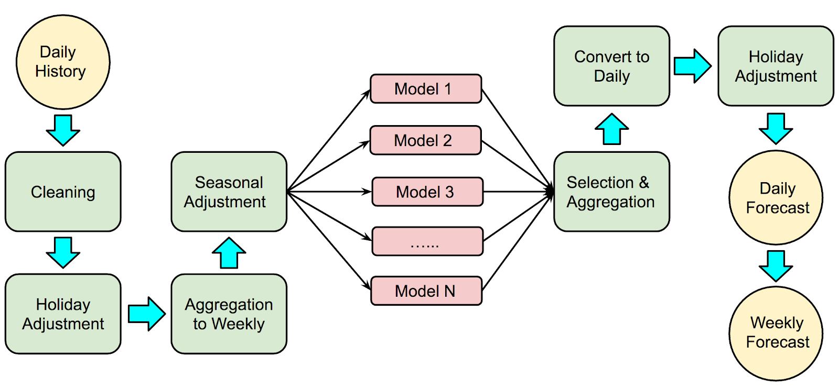
Forecasting in Context : Turkish Energy Demand

Slide 4
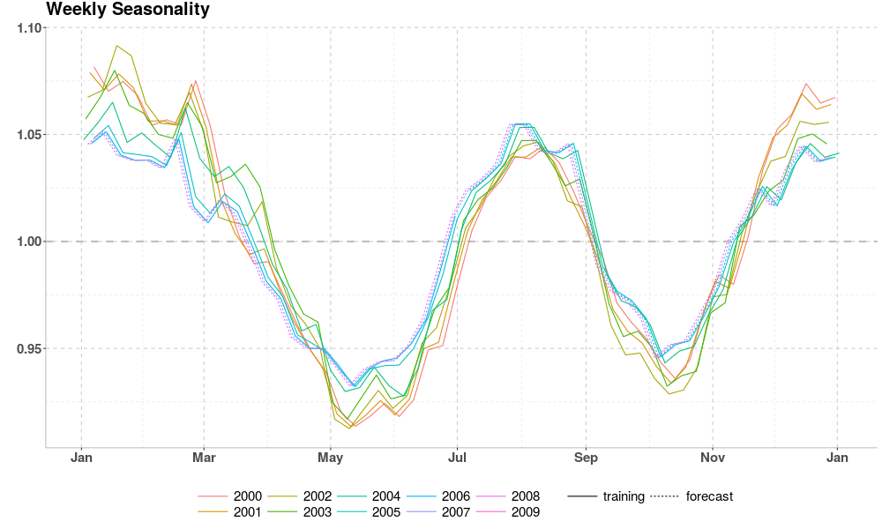
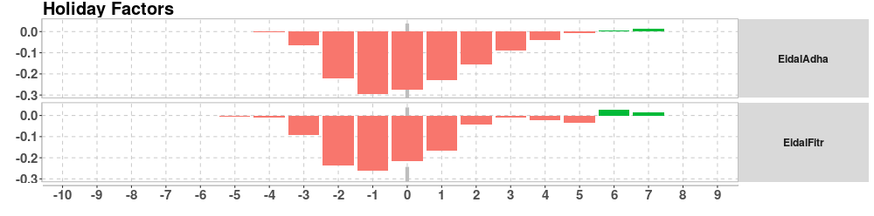
Forecasting in Context : Turkish Energy Demand

Slide 5
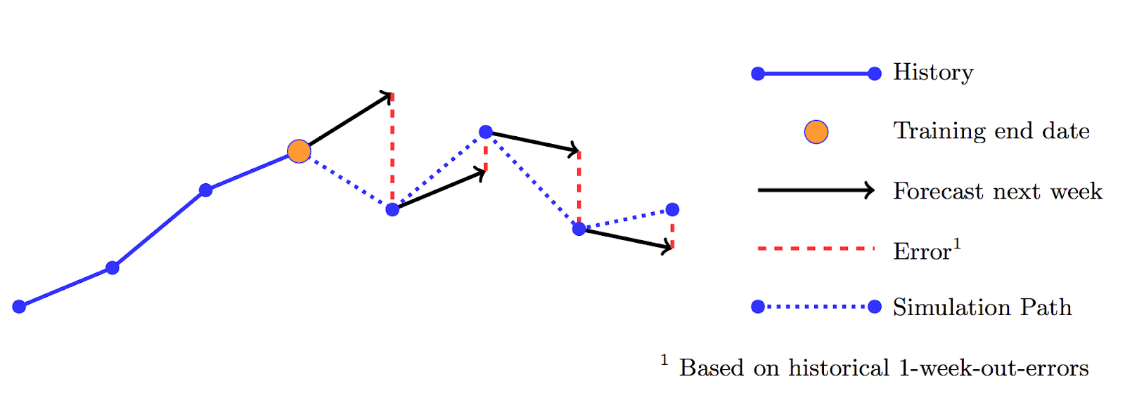
Forecasting in Context : Turkish Energy Demand

Slide 6
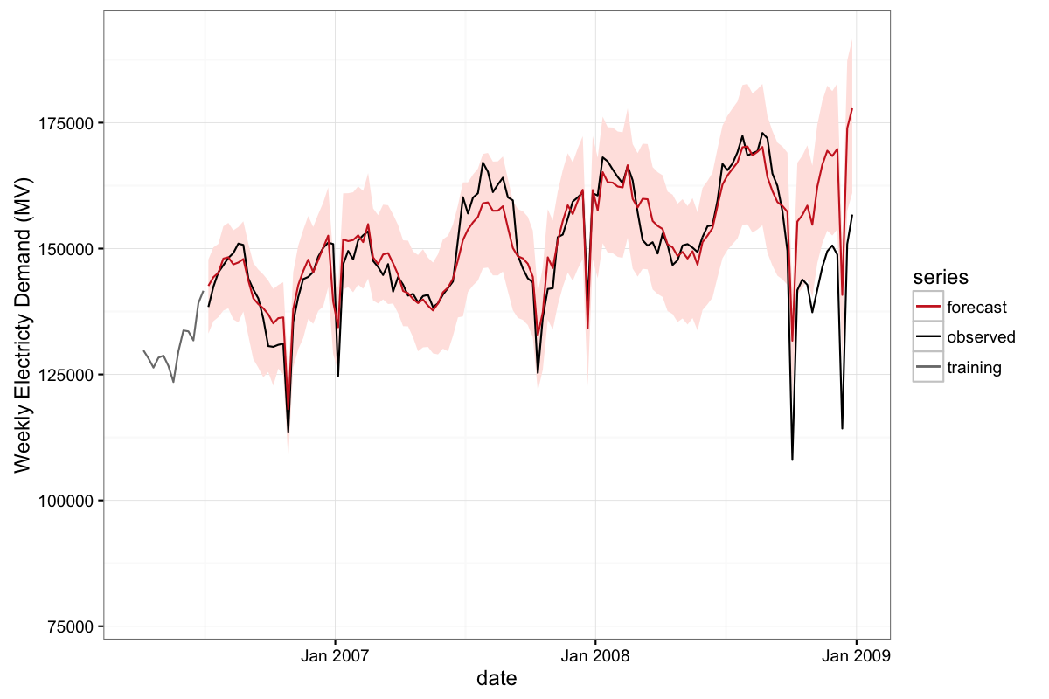
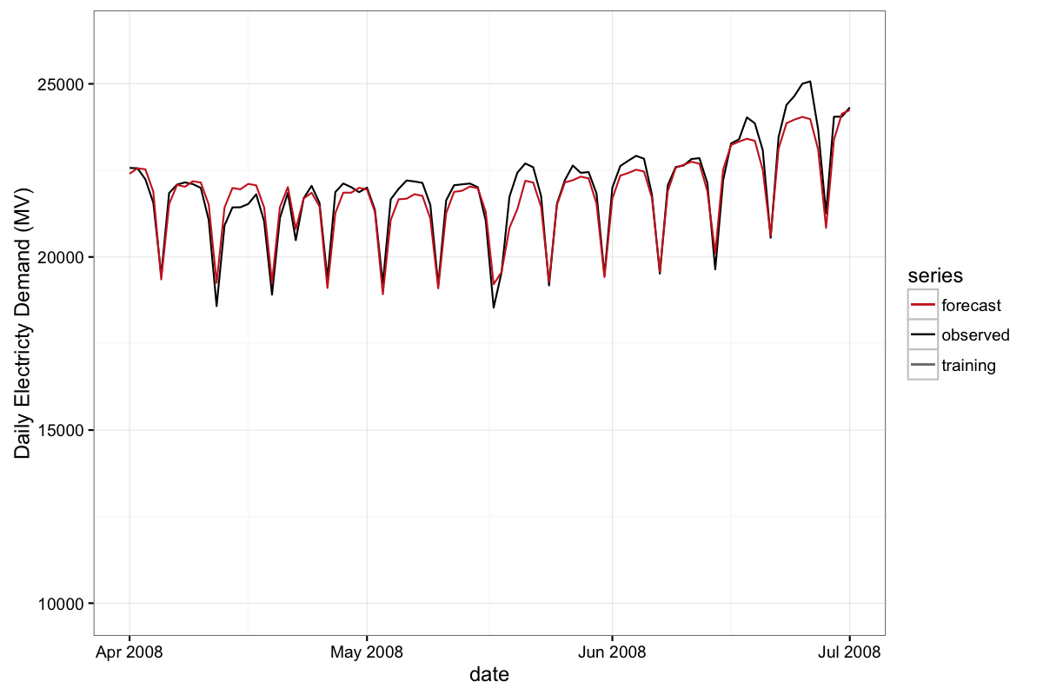
Forecasting in Context : Turkish Energy Demand

Slide 7
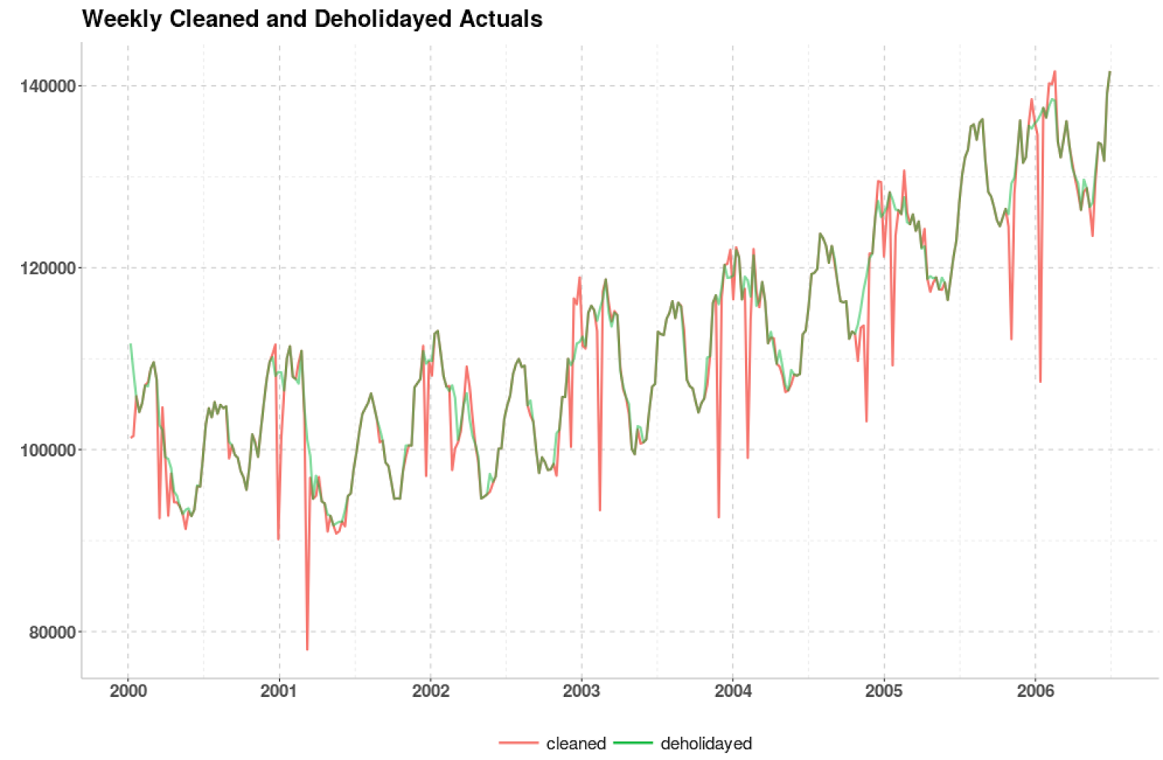
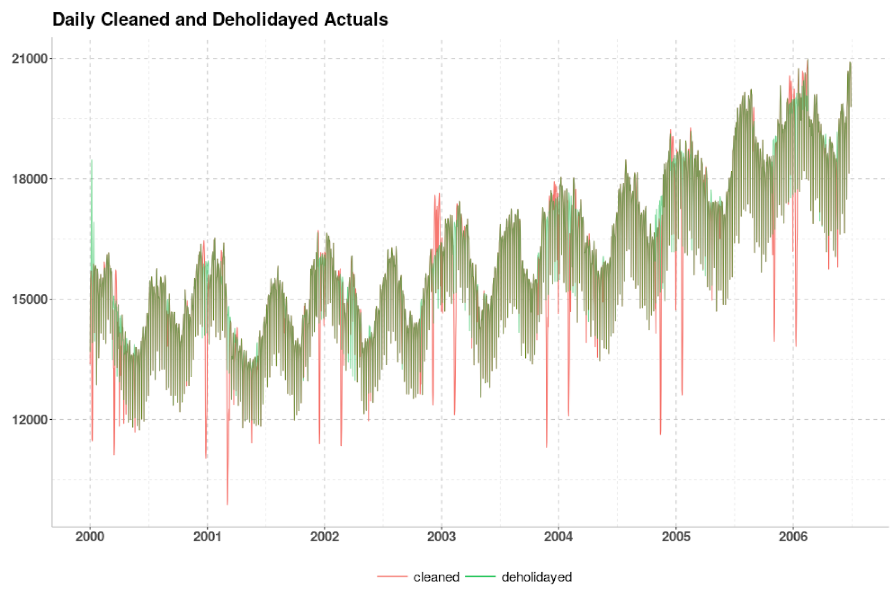
Forecasting in Context : Turkish Energy Demand

Slide 8
Timeseries Forecasting :
So what problems are we facing here ?
How can we solve them?
What if we ...

Slide 9
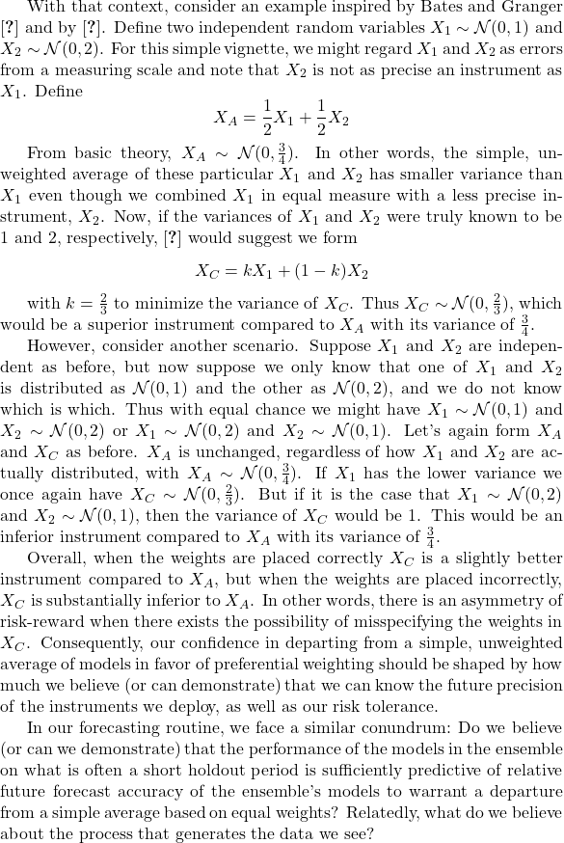

Slide 10
Timeseries Forecasting : Issues
From a conventional forecasting point of view, using a combination of forecasts amounts to an admission that the forecaster is unable to build a properly specified model. Trying ever more elaborate combining models seems only to add insult to injury, as the more complicated combinations do not generally perform all that well.

Slide 11
Timeseries Forecasting :
What is it actually?
Do you have any examples ?
What is it used for ?
Notes:
ARIMA (AutoRegressive Integrated Moving Average) is a traditional statistical model that excels in analyzing time series data with clear trends or seasonal patterns. It combines autoregressive components (which predict future values based on past values) and moving average components (which smooth out noise and fluctuations) to model time series data effectively.
LSTM (Long Short-Term Memory) Networks are a type of recurrent neural network (RNN) specifically designed to address the challenge of capturing long-term dependencies in sequential data. Unlike standard RNNs, LSTMs can remember information for an extended period, making them particularly useful for applications where the context or the sequence's history is crucial for prediction.
Prophet, developed by Facebook, is a forecasting tool tailored for time series data that displays patterns on different time scales, such as daily, weekly, or yearly trends. It is robust to missing data and outliers, making it a flexible option for real-world time series forecasting problems where data may be imperfect.
XGBoost (Extreme Gradient Boosting) is an advanced ensemble learning algorithm known for its efficiency and effectiveness in handling a wide range of data science problems, including time series forecasting. XGBoost builds upon the concept of gradient boosting, where multiple models (typically decision trees) are trained sequentially, with each new model correcting errors made by the previous ones. This process continues until a specified number of trees are created or no further improvements can be made.
XGBoost stands out for its ability to handle large and complex datasets with high-dimensional features. employs a sophisticated optimization algorithm to find the best model fit, making it highly accurate for predictive tasks. One of the key features of XGBoost is its use of gradient boosting framework, which minimizes a loss function over all predictions. This approach allows XGBoost to fine-tune its predictions and improve accuracy iteratively.
XGBoost also offers several advantages that make it particularly appealing for time series analysis:
Efficiency: XGBoost is designed to be highly efficient, both in terms of computation and memory usage. It utilizes parallel processing and tree pruning techniques, which significantly speed up the learning process and improve the model's performance.
Flexibility: It can handle various types of data (including categorical and continuous features) and can be used for both regression and classification problems, making it versatile for different time series forecasting scenarios.
Regularization: XGBoost includes L1 (Lasso regression) and L2 (Ridge regression) regularization terms in the objective function, which helps prevent overfitting by penalizing complex models. This regularization feature is particularly useful in time series forecasting, where models might overfit to noise in the training data.
Handling Missing Values: XGBoost can automatically handle missing data, reducing the need for complex data preprocessing steps. This feature is beneficial in real-world time series datasets, where missing values can be common.
Tuning and Customization: XGBoost offers a range of hyperparameters that can be tuned to optimize model performance, including learning rate, depth of trees, and regularization terms. This level of customization allows data scientists to fine-tune their models for specific forecasting tasks.

Slide 12
Timeseries Forecasting : Examples
ARIMA (AutoRegressive Integrated Moving Average)
LSTM (Long Short-Term Memory) / recurrent neural network (RNN)
XGBoost (Extreme Gradient Boosting)
Did we read the same paper ? Yes !
Notes:
XGBoost stands out for its ability to handle large and complex datasets with high-dimensional features. It employs a sophisticated optimization algorithm to find the best model fit, making it highly accurate for predictive tasks. One of the key features of XGBoost is its use of gradient boosting framework, which minimizes a loss function over all predictions. This approach allows XGBoost to fine-tune its predictions and improve accuracy iteratively.
XGBoost also offers several advantages that make it particularly appealing for time series analysis:
Efficiency: XGBoost is designed to be highly efficient, both in terms of computation and memory usage. It utilizes parallel processing and tree pruning techniques, which significantly speed up the learning process and improve the model's performance.
Flexibility: It can handle various types of data (including categorical and continuous features) and can be used for both regression and classification problems, making it versatile for different time series forecasting scenarios.
Regularization: XGBoost includes L1 (Lasso regression) and L2 (Ridge regression) regularization terms in the objective function, which helps prevent overfitting by penalizing complex models. This regularization feature is particularly useful in time series forecasting, where models might overfit to noise in the training data.
Handling Missing Values: XGBoost can automatically handle missing data, reducing the need for complex data preprocessing steps. This feature is beneficial in real-world time series datasets, where missing values can be common.
Tuning and Customization: XGBoost offers a range of hyperparameters that can be tuned to optimize model performance, including learning rate, depth of trees, and regularization terms. This level of customization allows data scientists to fine-tune their models for specific forecasting tasks.

Slide 13
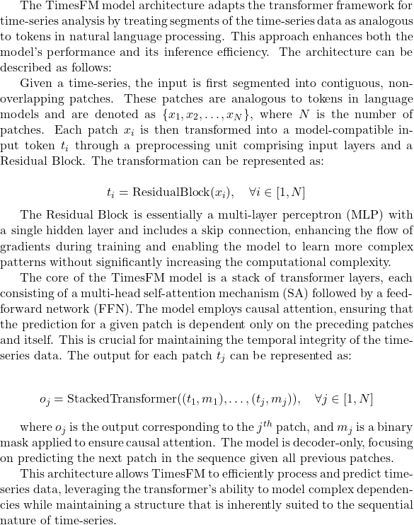

Slide 14
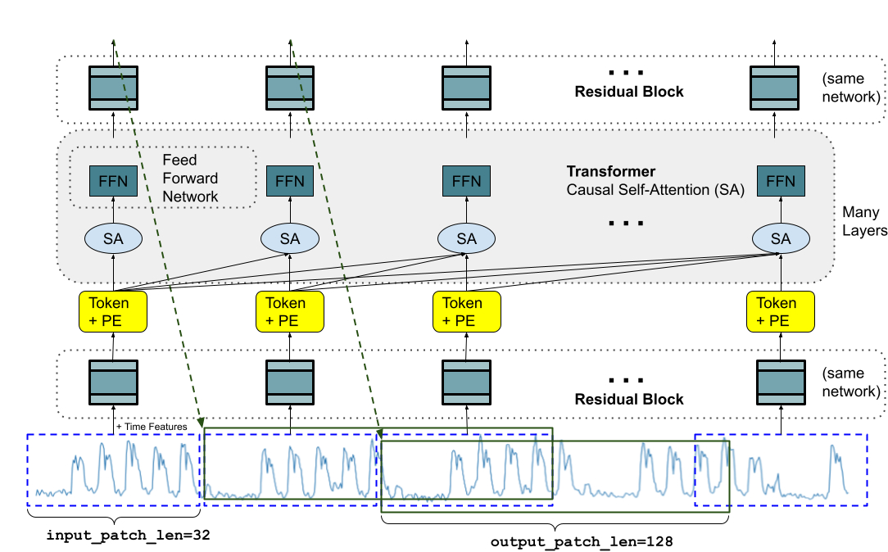
Timeseries Forecasting : “🤔What ?”

Slide 15
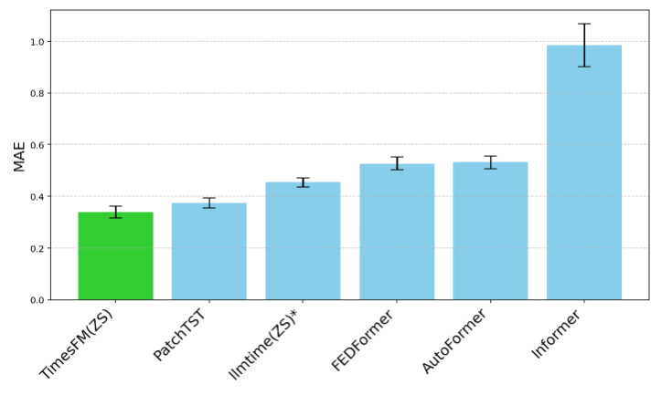
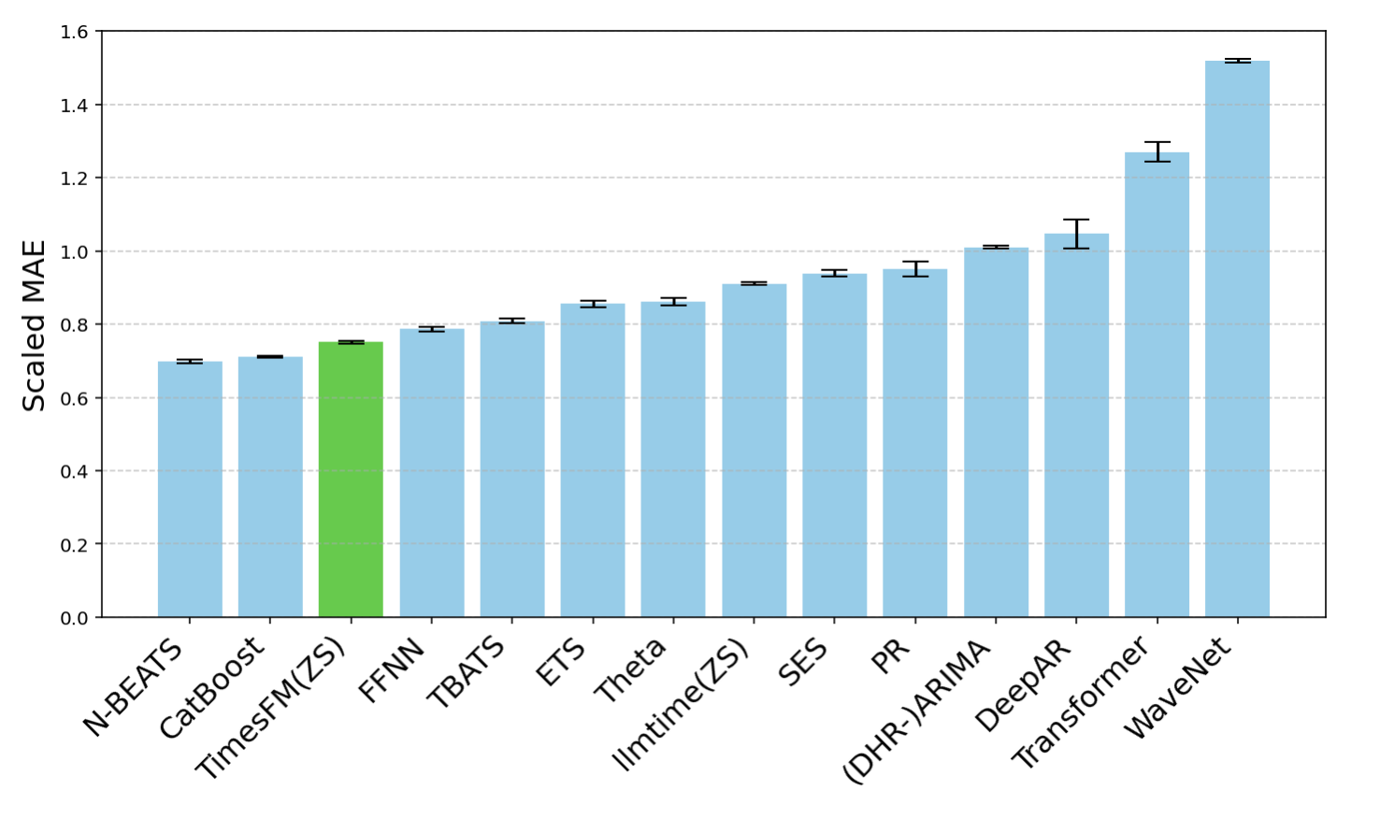
Timeseries Forecasting : Evals (lower is better)

Slide 16

Timeseries Forecasting : What do You think ?

Slide 17
Timeseries Forecasting : Further Research
1. Exploration of Advanced Temporal Processing Techniques:
2. Lack of Alternative Solutions and Future Directions:
3. Addressing the Verification of Predictions:
4. Statistical Analysis of Model Performance:
5. Handling of Dynamic Contexts and the "Big N(0) Problem":
6. Salesforce Vs Google : https://arxiv.org/pdf/2402.02592.pdf
7. FredF : https://arxiv.org/abs/2402.02399
Notes:
1. Exploration of Advanced Temporal Processing Techniques:
The researchers could benefit from examining techniques used in video game rendering, such as Temporal Anti-aliasing (TAA) and Deep Learning Anti-Aliasing (DLAA). These methods, which focus on improving image quality by addressing temporal aliasing in pixel vectors, share conceptual similarities with the task of forecasting in time-series data. The analogy lies in the handling of temporal sequences—whether they be pixel vectors in video games or token vectors in time-series forecasting. Investigating these techniques could yield novel insights into reducing noise and improving the accuracy of forecasts in time-series data.
2. Lack of Alternative Solutions and Future Directions:
While the paper concludes with intentions to enhance the model's speed and practicality, it falls short of proposing concrete alternative solutions or thoroughly exploring avenues for future work. This omission leaves readers with questions about potential methodologies for addressing the model's limitations. Future iterations of this research could benefit from a more detailed roadmap that includes exploring alternative architectures, loss functions, or pretraining strategies that could address current shortcomings.
3. Addressing the Verification of Predictions:
A critical aspect of forecasting that the paper does not adequately address is the verification of predictions. Specifically, the methodology for determining the accuracy of forecasts and correcting for biases introduced by non-deterministic interference or observational errors is not discussed. Incorporating mechanisms for validating guesses and adjusting for drift could significantly enhance the model's reliability and applicability in real-world scenarios.
4. Statistical Analysis of Model Performance:
The presentation of evaluation results lacks a detailed statistical analysis of the model's performance. Discussing the standard deviations, mean distributions of error, and bias would provide a more comprehensive understanding of the model's forecasting capabilities and limitations. Such an analysis is crucial for assessing the model's robustness and for benchmarking against other forecasting methods.
5. Handling of Dynamic Contexts and the "Big N(0) Problem":
The critique raises an important point regarding the model's handling of a large number of predictions ("the big N(0) problem") and its ability to dynamically adjust to varying contexts. The efficiency of sorting and selecting the most relevant forecasts from a multitude of possibilities remains unclear. Future work should explore strategies for efficiently managing and evaluating a vast array of predictions, especially in dynamically changing environments.

Slide 18
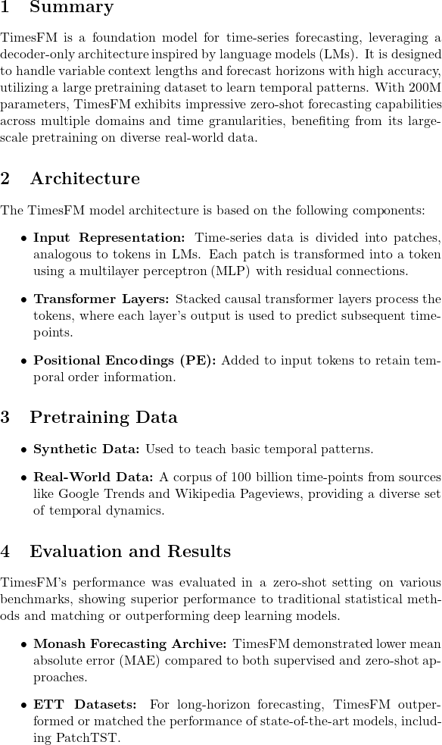

Slide 19
Sources
- google blog : https://blog.research.google/2024/02/a-decoder-only-foundation-model-for.html
- paper : https://arxiv.org/pdf/2310.10688.pdf
- analytic girl blog : https://medium.com/@analyticgirl/google-just-published-a-decoder-only-or-time-series-forecasting-06c3ad4f79d0
- twitter posts : https://twitter.com/predict_addict/status/1754117698001219595?s=20

